Slide 1


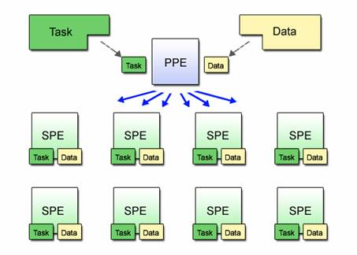
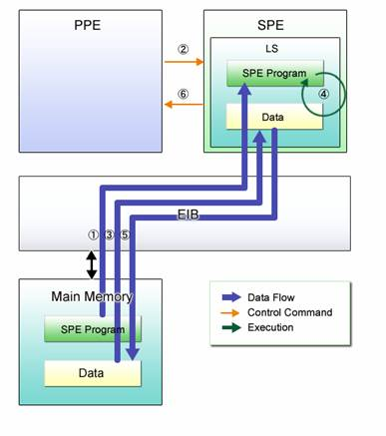
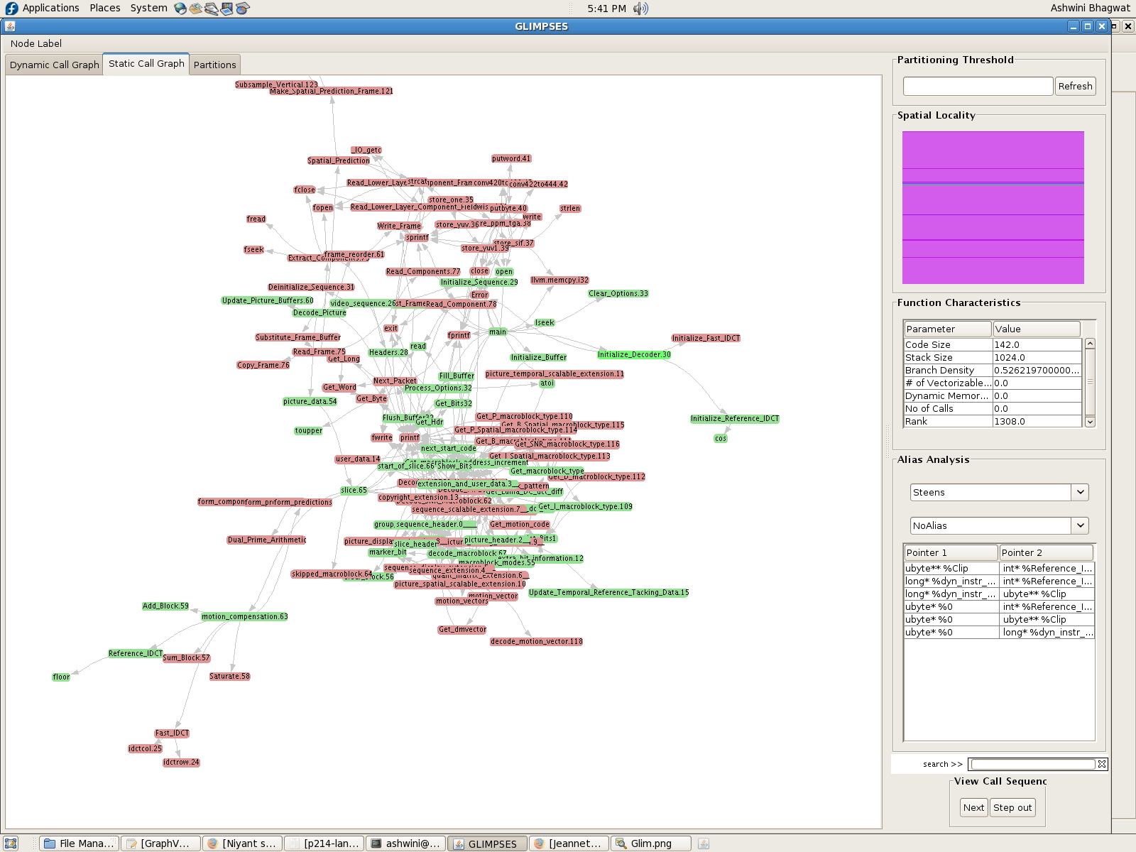
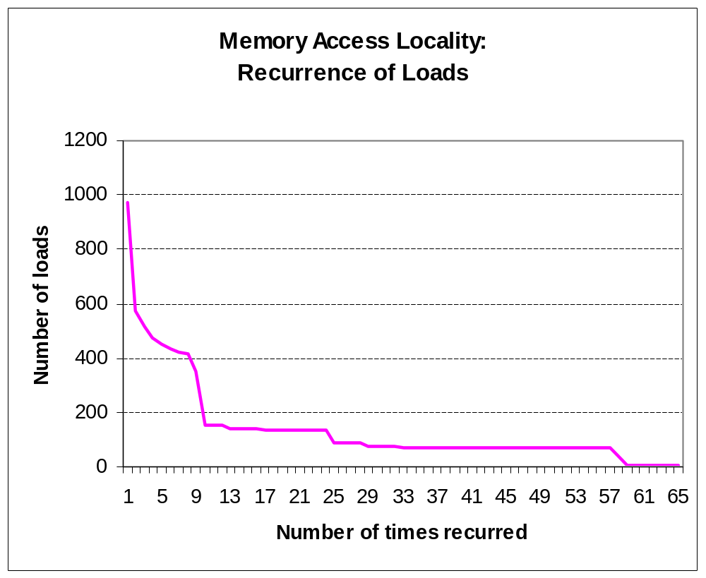
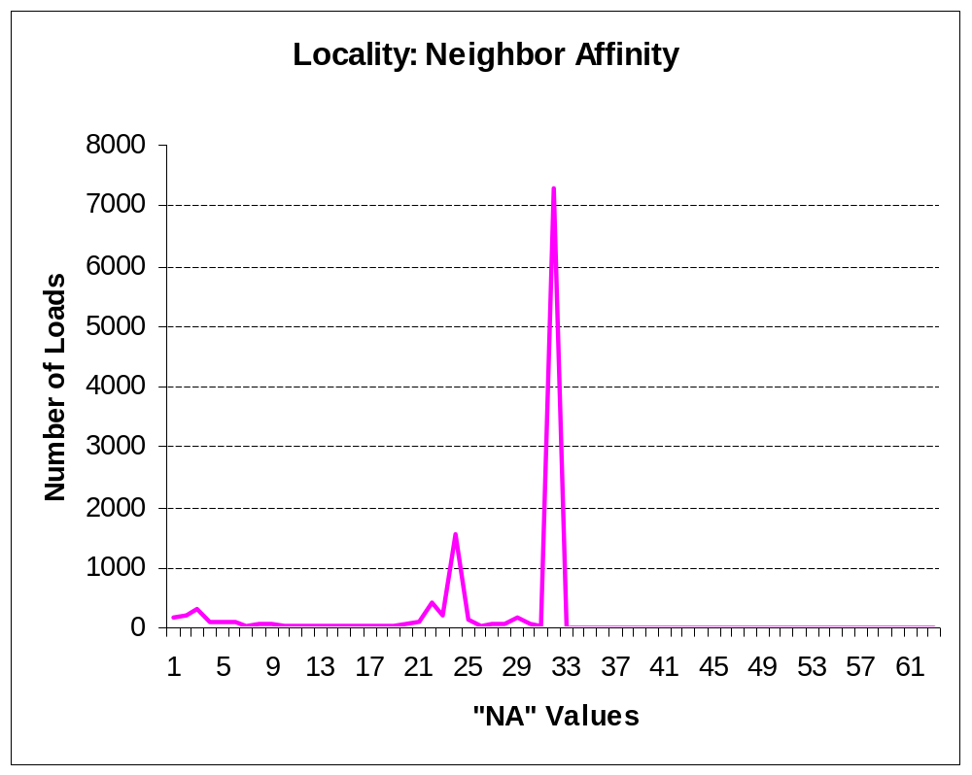
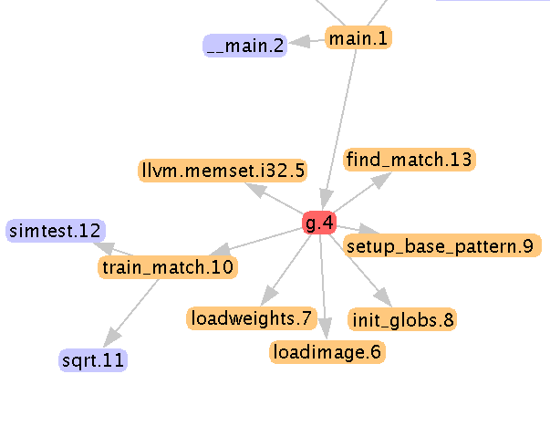
GLIMPSES : Global Interprocedural Memory and Partition Estimator
Jaswanth Sreeram, Ashwini Bhagwat, Santosh Pande
jaswanth@cc.gatech.edu, ashwini@cc.gatech.edu, santosh@cc.gatech.edu
Motivation
Memory Allocation Behavior
Alias Analysis
Screenshot
Porting large codebases to SPEs is challenging
Limited local store
High branch penalty
Geared towards vectorizable code
Code/data partitioning is not trivial
SPE/PPE interactions
Estimate static and dynamic memory allocation
Code, stack and heap (per function)‏
Usage < SPU Local Store limit ?
Analytical estimation
  Detect program objects affecting dynamic memory behaviour
  Show correlation between these program objects and memory usage
    What is an alias?
    Two variables referring to the same memory location
    In C, if p = &i, then <*p, i> is an alias pair
  Why do we care about Aliases?
    More accurate memory dependence analysis and data flow analysis
    More accurate partitions
    Prefetching data needed by an SPU
    Synchronizing memory accesses on the SPU
  Implementation in Glimpses
    Existing LLVM Alias analysis implementations are being used to get Alias analysis information for each function
    The Alias analysis algorithm returns “Must”, “May” or “No” Alias as the result.
    Interprocedural Alias analysis is carried out to determine how tightly coupled two procedures, and make better partitioning decisions
    This information is represented in the Glimpses UI for the programmer to analyze his code better and make changes if required.
Static & Dynamic Call Graphs
Program Partitioning
Spatial Locality
Provide programmer with tools to
Understand dynamic program behaviour
Quickly construct candidate partitions for SPEs
Evaluate/Quantify partitions’ suitability for SPEs
Memory Reference Patterns
Locality metrics for loads/stores
Spatial Locality
  “Loads to different addresses in a spatial window”
Temporal Locality
  “Loads to same address in a time window”
Neighbour Affinity
  “Loads to addresses within a space and time window”
Tool Overview
Function
Characteristics
  Static Call Graph
  Dynamic Call Graph
  Memory Requirements
    Dynamic
    Analytical
  Memory Access Patterns
    Locality (spatial, temporal, hybrid)‏
  Alias Analysis Information ( Inter & Intra procedural)
  Partitioning
    Criteria based estimates
Function Characteristics - Code size, Stack size, Branch density, number of autovectorizable loops, Dynamic memory allocation, No of calls etc
Observe the overall program behaviour in the UI by viewing call graphs, node properties, alias information, step through the call graph to observe the program run, search for functions etc.
Specify different thresholds and observe partitions generated
Analytical Memory Estimator
Code
Function Search
Alias Analysis
for (……)‏
{
if (cc==0)‏
size = Picture_Width*Picture_Height;
else
size = Chroma_Width*Chroma_Height;
if (!(backward_reference_frame[cc] = (unsigned char *) malloc(size) ))‏
Error(..);
if (!(forward_reference_frame[cc] = (unsigned char *) malloc(size) ))‏
Error(..);
}
Program Partitioning
Play Dynamic Call Sequence
__Malloc_size__2 = 0 + Picture_Width*Picture_Height
__Malloc_size__3 = 0 + Picture_Width*Picture_Height
__Malloc_size__4 = 0 + Picture_Width*Picture_Height
__Malloc_size__5 = 0 + Chroma_Width*Chroma_Height
__Malloc_size__6 = 0 + Chroma_Width*Chroma_Height
__Malloc_size__7 = 0 + Chroma_Width*Chroma_Height
__Malloc_size__8 = 0 + Chroma_Width*Chroma_Height
Status
  Several features and improvements planned
    Demand Driven Alias Analysis
    Refining the partition set with Information about relationships between functions like Alias analysis information, data flow dependencies between functions etc.
    Alias Analysis information for data pinning/prefetching opportunities.
    Leverage DataStructureAnalyses for smart memory allocation on SPUs
    Code Generation after partition generation
    Improved visualization schemes for Memory Locality, Alias Analysis Information etc.
  Tested on
    Many workloads from SPECINT
    Many workloads from mediabench
    ODE (Open Dynamics Engine)‏
  Open Source Beta will be released soon
  Input : Static Call Graph G with a rank for each function which aggregates the function properties.
  Output: A set of subtrees where the cumulative rank of each subtree is less than a specified threshold T
  Calculate the rank of each function by aggregating the function properties
    Propagate the rank upward so that each function represents the rank of all functions below it
    To partition, start with the root to check if its rank is greater than the Threshold T
      If it is, the subgraph below it is a new partition
      If not, start examining each of the child nodes in a similar fashion
Methodology
C/C++ program
LLVM compiler flow
Analytical
Memory Estimator
Alias Analyisis
Dyn. Memory Estimator
Bytecode
Locality Measures (mpeg2decode)‏
Analysis &
Instrumentation Passes
Runtime
Link
Instru. Bytecode
Visualization Engine
Inputs
Execute
User Input
Partition Estimator
Partitions

